Slide 1
Our Journey
Implementing the Learning from Deaths framework at Barts Health NHS Trust
Victoria Thickett
CEU Manager
Notes:
About me:
CEU – Alongside mortality, responsible for National Audit, NICE guidance, Consultant participation, Audit and RCA of some patient harms (VTE, IPC)
Joined the Trust in 2013, when barts had the 5th lowest SHMI in England. Investigated this and found inconsistencies at St Barts, changed denominator
Key achievements is relegating Barts down to 20th, still lower than expected though ☺

Slide 2
Session
Developing a new process and framework in a large NHS organisation
The importance of having both qualitative and quantitative data

Slide 3
The Trust
Largest NHS Trust in England (at the time)
3000 in-patient deaths per year
Largest A&E service in England
Primary, Secondary and Tertiary Care
Notes:
(We’re now the third largest)
With 800 further deaths outside of hospital within 30 days of discharge.
Around half a million A&E visits per year.
Predominantly acute secondary care, also GP, community and integrated care services, along with specialist and tertiary services: HA centre, Trauma, HPB, Cancer

Slide 4
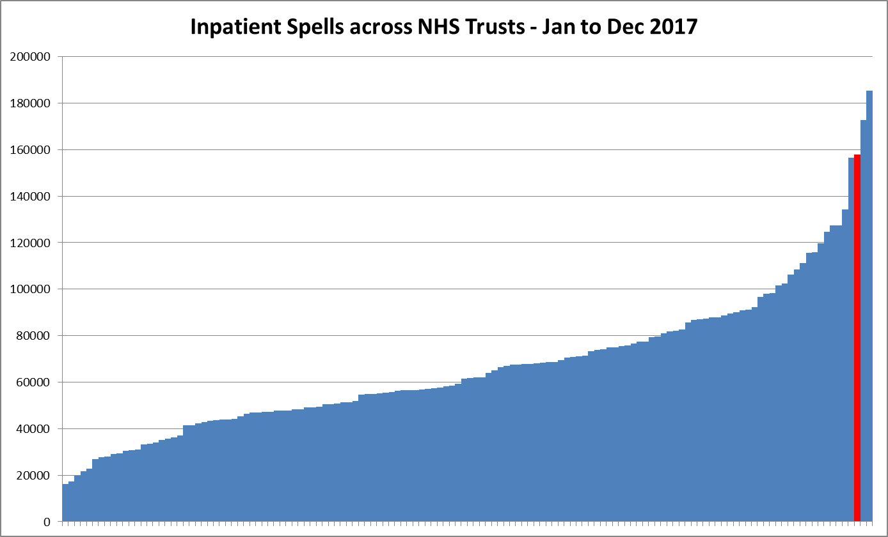
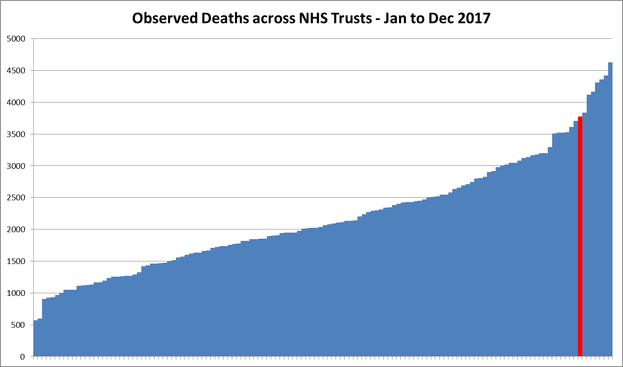
Heart of England
185424 spells, 4624 deaths
Manchester University
172679 spells, 3526 deaths
Barts Health
157921 spells, 3777 deaths
Notes:
Idea of what this looks like visually
- Manchester University was No 1 as of October 2017 and moved to No 2 when,
Heart of England NHS Trust is No 1 as of April 2018,
Very big trust with a large number of deaths to review

Slide 5
The Domino Effect
Dec 2016: CQC – “Learning, Candour and Accountability”
Dec 2016: DoH – Statement
March 2017:
NQB “Framework for Learning from Deaths”
Notes:
CQC report: found that some NHS Trusts were not giving sufficient priority to learning from deaths and were therefore missing opportunities to improve care and gave recommendations
DoH: Agreed with the CQC and said from March 2017 these would be an expectation
NQB: published a guide to help support implementation (bearing in mind this was supposed to be in place from April 2017)

Slide 6
The Starting Point
Established Trust Mortality Review Group
Risk-adjusted Mortality data
Outliers
Inconsistent local M&M review
Notes:
Where were we in Dec 2016…
Chaired by CMO with reps from each site / CAG
Looked at SHMI, RAMI, HSMR (with help from CHKS); quarterly report and attendance from Richard Coombes.
Outliers from internal trends, CQC, National audits, low mortality HRG groups
Exemplar areas such as trauma, HEMS, gastro and other areas with no process

Slide 7
The Expectation
The Plan
Quarterly publication of avoidable deaths data
Highlight patients with vulnerabilities
Publish a policy
Develop a dashboard
Build a form
Link with clinical colleagues
Publish a policy
Notes:
Number of deaths, number reviewed, number avoidable by the end of 2017
Learning disabilities, severe mental health issues
Publish a policy by the end of Sept 2017
(Don‘t go into too much detail as next slides cover dashboard and form)
Clinical colleagues are LD nurse, Safeguarding

Slide 8
The Leadership and Team
Exec and Non-Exec Director
Consultant Clinical Site Leads
Patient Safety
Clinical Effectiveness
CHKS
Notes:
Started with the team:
NED = Part of the expectation
Juggernaut needs site breakdown – local mortality champions (4 consultants)
Patient safety involvement

Slide 9
The Policy
Which patients to review?
How to review?
Who will review?
When to review?
Notes:
NQB framework recommends all patients with LD and SMH aged 4 and over and a random 10% of all other inpatients aged 18 and over for review
We decided to review 100% of patients with an initial review (stage 1) and grade NCEPOD A-E, report E, 2nd Stage D and some B/Cs.
Maternal deaths, patients under an SI.
Massive workload, Push back to the services; traditional approach
Stage one within two weeks, Stage 2 within two months.
Published on time Sept 2017.

Slide 10
The Form
Collaborative
Comprehensive
Data driven
eForm
Notes:
Input from all stakeholders: palliative care, infection control, dementia, public health
Comprehensive but not too bad at 2 A4 pages long
Mostly checkboxes with a view to prepopulating demographics (auditable!)
Build a powerform with Clinical Systems for inclusion in patient record
Logistically, paper form until form can be built
Piloted on each site in a range of specialties

Slide 11
The Methodology
Structured Judgement Review
Narrative framework
In-depth
Notes:
RCP published SJR methodology - Needed a stage 2 review form.
One day training course.
Narrative about each section of care, scoring each section Harvard 1 to 6.
8 pages, 6 (optional) covering all stages of care eg. Admission, critical care, surgery etc.
2 covering further demographics and related questions.

Slide 12
The Dashboard
Notes:
We put together a simple dashboard: Q2 data here our first publication.
68% is pretty good
But why not 100%?

Slide 13
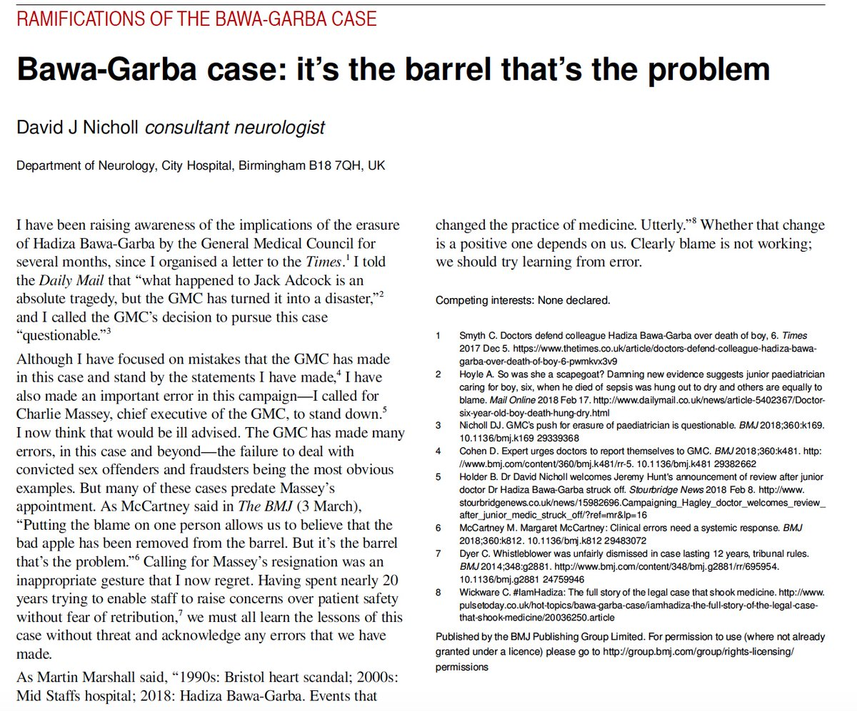
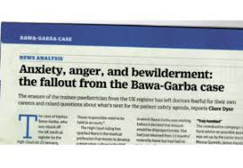
The Barriers
Workload
IT infrastructure
Prescribed methodology
Blame
Notes:
- Having to look at everyone, varied patient numbers across the trust (e.g. Maternity vs CoE), part of daily administration (not job planned)
Form built by Nov 2017 (submitted in May 2017 unlucky due to Cyber Attack) but not usable due to an issue with prepopulating demographics
Paper forms but still limited assurance on use of the form; services keeping reviews locally and providing numbers to site leads
Teams that already had review systems in place still reluctant to move to a new process.
Confusion around “Avoidable” – reason I have given no definition is that there isn’t an official one.
“Inpatient deaths where there were issues with the management of the patient that adversely affected the outcome.” – Some were not avoidable!!
Blame – Familiar with Bawa-Garba? Struck from the GMC register (and re-instated) for mistakes in care that led to an avoidable death of a child.
Entire presentation on this but essentially, who is responsible when good practice is not supported by the system? As the article says….
Teams are worried to review practice if they may be blamed – especially when notes used as evidence.

Slide 14
The Solution 2.0 – The Medical Examiner
Proactive
Independent
Contact point
Notes:
Completes stage form within 1 working day (i.e. Friday done on Monday) at most a week in high volume
Clinical expertise but separate from admitting clinical team; picks areas of care to look into specifically
Call families within one day who may have not had verbal contact from Trust
Accountability for getting responses and reviews from clinical teams.
Piloted this in Q3 with one person, rota at the RLH for Q4.

Slide 15
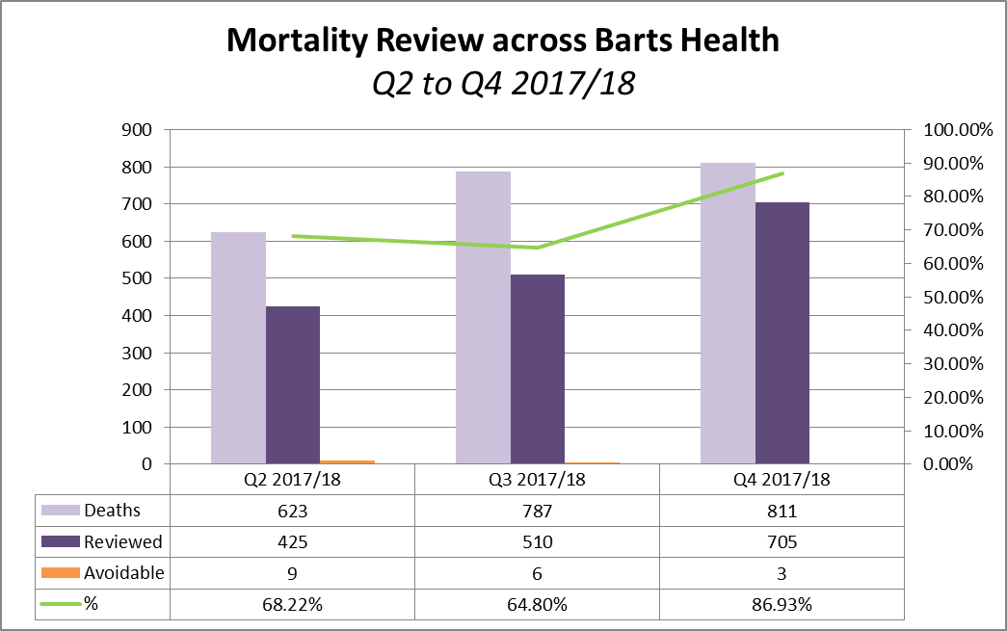
The Results

Slide 16
The Benefits
Assurance and oversight
Proactive review of trends
Coding and Data Quality
Communication with families
Notes:
The ME sees every case and picks those that go on for review
Trends and outlier investigations already have a majority of patients reviewed before any work commences along with SHMI/RAMI
In an increasing number of areas, we know there’s an issue and CHKS have produced a report before anything get to external notification
Also, removes the need to contact the clinical team and explain the model before the review takes place and argue about DQ
We are speaking their language!
…and DQ is better - The ME picks up key co-morbidities and the coders get to see the stage one review which improves this area and so our RAMI/SHMI
The ME speaks to everyone, significance unconfirmed but a decrease in complaints made by families following death.

Slide 17
The Future
Online System, linked to Governance
Substantiative Posts
Learning Trends
Notes:
We’re trying again – instead of redoing the patient record, move under governance as a safety expectation (legal, complaints, SIs)
Local heroes are essential at first but not sustainable - Employing PAs for ME, ahead of this being implemented in 2019
Obvs sharing the learning, documenting actions and using this to identify trends across the organisation, big data/research

Slide 18
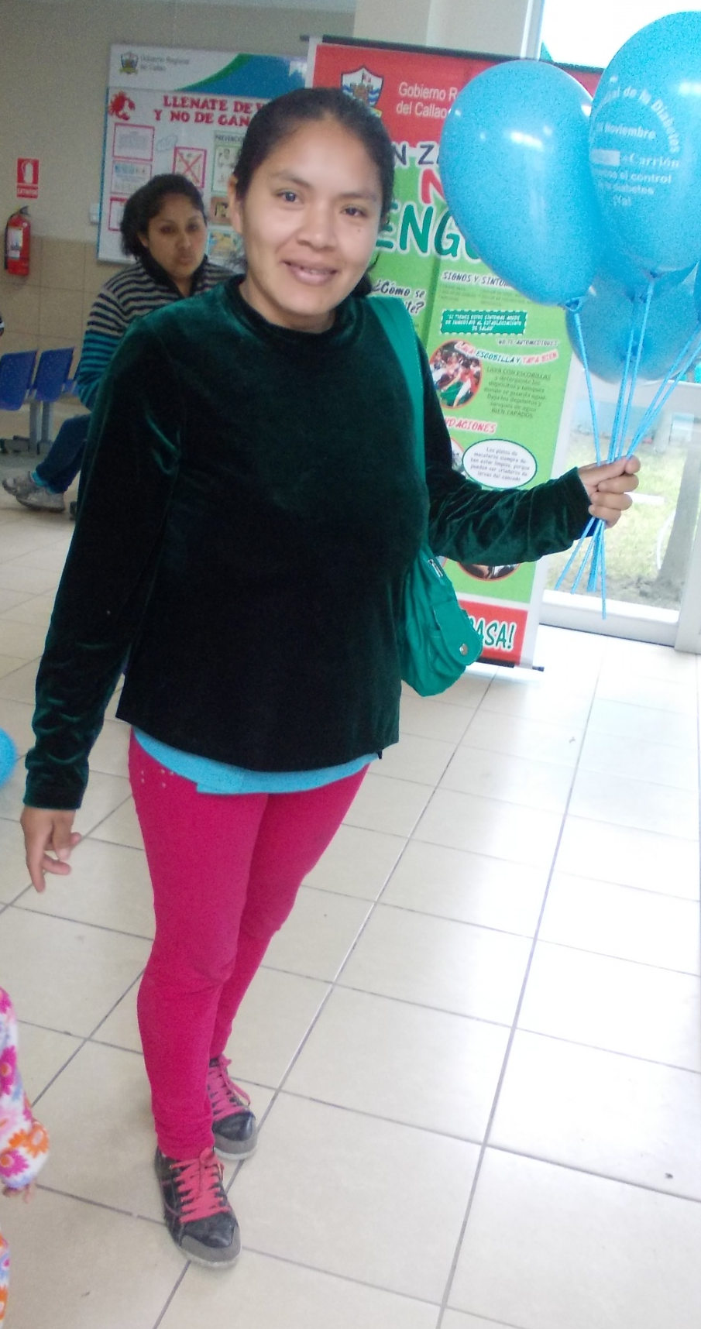
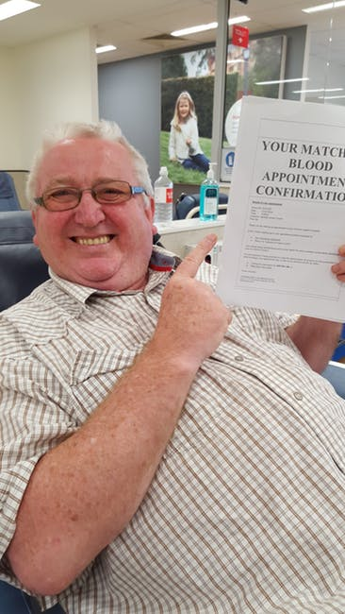
The Results
Notes:
Bridging the gap between viewing the system as anonymous figures, models and metrics to a view of the system as many individuals.
All important and all contributing to our improvement and to giving us better information.

Slide 19
Any Questions?

